Slide 1
Next Generation Sequencing Technologies, Application, Hardware, Software

Slide 2
Outline
Introduction, Presentation, Goals.
Next generation sequencing technologies.
Bioinformatics challenges.
Some aspects of NGS data analysis.
Conclusions and perspectives

Slide 3
Introduction

Slide 4
Why is NGS revolutionary?
NGS has brought high speed not only to genome sequencing and personal medicine,
it has also changed the way we do genome research
Got a question on genome organization?
SEQUENCE IT !!!

Slide 5

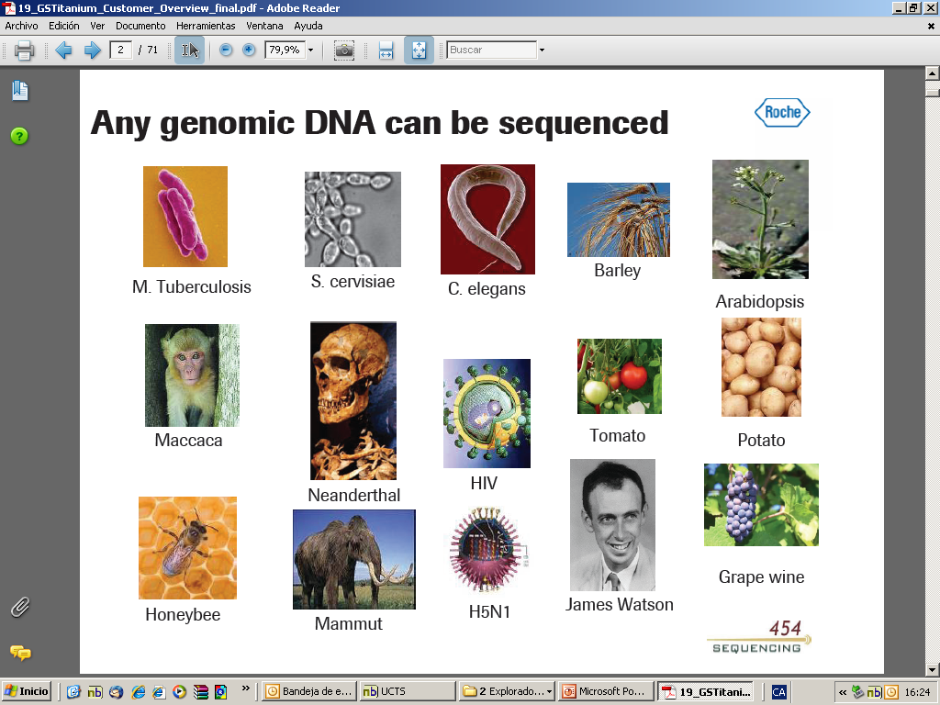
Any DNA can be sequenced
S. cervisiae
Barley
M Tuberculosis
C. elegans
Arabidopsis
Tomato
Maccaca
HIV
Potato
Neanderthal
James Watson
Honeybee
H5N1
Grape wine
Mammut
Notes:
5

Slide 6
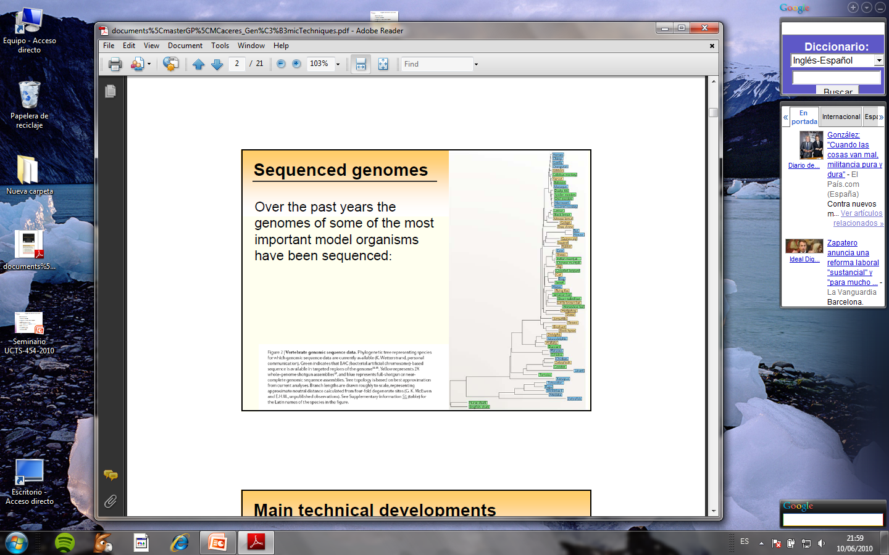
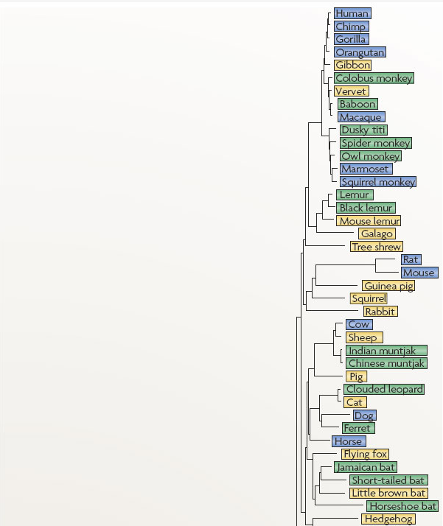
Sequenced genomes
Nature Reviews Genetics 9, 303-313, 2008
Over the past years the genomes of some of the most important model organisms have been sequenced:
Figure 2. Vertebrate genomic sequence data. Phylogenetic tree representing species for which genomic sequence data are currently available Green indicates that BAC (bacterial artificial chromosome)-based sequence is available in targeted regions of the genome^{11, 15}. Yellow represents 2X whole-genome shotgun assemblies¹⁷, and blue represents full-shotgun or near-complete genomic sequence assemblies.
Notes:
Actualmente disponemos de las secuencias genómicas de algunas de las especies más importantes y la comparación de estos genomas es la aproximación hoy día más común para la indentificación y caracterización de regiones funcionales en los genomas de estos organismos que es lo que ha ayudado a establecer relaciones filogenéticas entre especies.
La long. De las ramas de este árbol filogénetico basado en lacomparación de secs de DNA muestra cómo de cercana es la relación entre las especies.
6

Slide 7
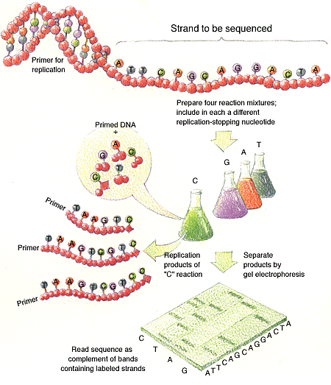
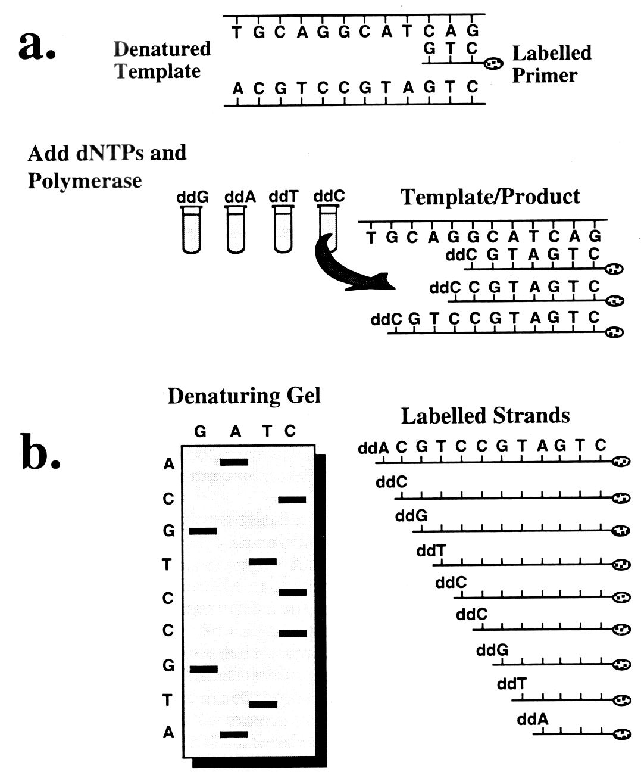
Sequencing: the Sanger Method (1977)
Click here to see an animation
Notes:
Animacio
http://highered.mcgraw-hill.com/sites/0072556781/student_view0/chapter15/animation_quiz_1.html
Esquerra: Sanger sequencing (de http://yenoh93.medceu.com/index/courses/genome.htm)
In the much-automated Sanger sequencing method, the single-stranded DNA to be sequenced is "primed" for replication with a short complementary strand at one end.
This preparation is then divided into four batches, and each is treated with a different replication-halting nucleotide (depicted here with a diamond shape), together with the four "usual" nucleotides.
Each replication reaction then proceeds until a reaction-terminating nucleotide is incorporated into the growing strand, whereupon replication stops. Thus, the "C" reaction produces new strands that terminate at positions corresponding to the G's in the strand being sequenced. (Note that when long strands are being sequenced the concentration of the reaction-terminating nucleotide must be carefully chosen, so that a "normal" C is usually paired with a G; otherwise, replication would typically stop with the first or second G.)
Gel electrophoresis -- one lane per reaction mixture -- is then used to separate the replication products, from which the sequence of the original single strand can be inferred.
Dreta (http://www.nwfsc.noaa.gov/publications/techmemos/tm17/figures/moranfig4.htm )
Sanger dideoxy chain termination sequencing. Panel a illustrates the products of the polymerase reaction taking place in the ddCTP tube.
The polymerase extends the labelled primer, randomly incorporating either a normal dCTP base or a modified ddCTP base.
At every position where a ddCTP is inserted, polymerization terminates; the end result is a population of fragments; the length of each is a function of the relative distance from the modified base to the primer.
Panel b shows electrophoretic separation of the products of each of the four reaction tubes above (ddG, ddA, ddT, and ddC), run in individual lanes. The bands on the gel represent the respective fragments shown to the right. The complement of the original template (read from bottom to top) is given on the left margin of the sequencing gel.

Slide 8
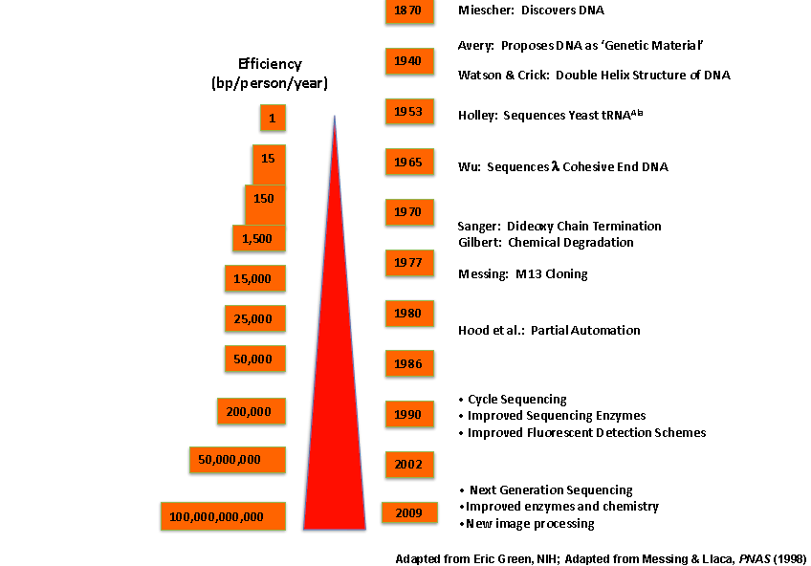
History of DNA sequencing is related to the combination of new technologies.
Notes:
History of DNA sequencing is related to the combination of new technologies.
Applications of new technologies to DNA sequencing have played a major role in the increase of the amount of DNA sequence generated per person per year at a greater cost efficiency.
The introduction of chain terminators to DNA polymerase-based sequencing and separation of DNA tracts by PAGE were based on new nucleic acid chemistries.
However, without the integration of the DNA sequencing chemistry and DNA cloning, the sequencing of whole genomes would not be possible today.
Two other technologies greatly accelerated the speed of DNA sequencing, partial automation with laser detection systems and the progress in computational hardware and software.

Slide 9
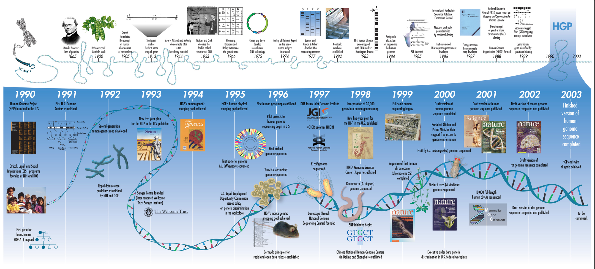
The human genome project

Slide 10
To know more about HGP
http://exploreable.wordpress.com/2011/05/03/the-story-of-the-human-genome-project-a-short-narration/
All about the human genome project
http://e2013.wordpress.com/2013/03/11/les-estadistiques-del-genoma/

Slide 11
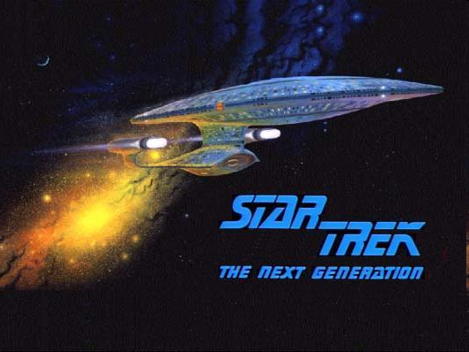

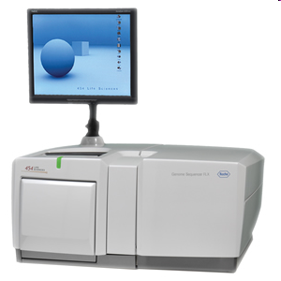
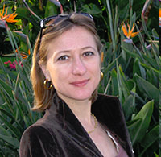
Next generation sequencing
The future is here, now

Slide 12
Next generation Sequencing
Improvements in enzymes, chemistry and image analysis, mature by the middle of last decade dramatically increased sequencing capabilities.
The newest type of technology, called “next-generation sequencing”, appeared with the potential to accelerate biological and biomedical research
by enabling the comprehensive analysis of genomes, transcriptomes and interactomes,
by tending to become inexpensive, routine and widespread, rather than requiring very costly production-scale efforts.

Slide 13
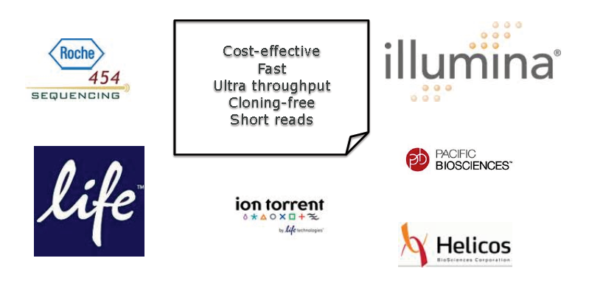
NGS technologies

Slide 14
Next-generation DNA sequencing
Sanger sequencing Cyclic-array sequencing
Notes:
Sanger sequencing
DNA is fragmented
Cloned to a plasmid vector
Cyclic sequencing reaction
Separation by electrophoresis
Readout with fluorescent tags
Cyclic-array methods
DNA is fragmented
Adaptors ligated to fragments
Several possible protocols yield array of PCR colonies.
Enyzmatic extension with fluorescently tagged nucleotides.
Cyclic readout by imaging the array.

Slide 15
Next-generation DNA sequencing
Sanger sequencing Next-generation sequencing
Advantages of NGS
- Construction of a sequencing library → clonal amplification to generate sequencing features

Slide 16
Next-generation DNA sequencing
Sanger sequencing Next-generation sequencing
Advantages:
- Construction of a sequencing library → clonal amplification to generate sequencing features
No in vivo cloning, transformation, colony picking...

Slide 17
Next-generation DNA sequencing
Sanger sequencing Next-generation sequencing
Advantages:
Construction of a sequencing library → clonal amplification to generate sequencing features
No in vivo cloning, transformation, colony picking...
- Array-based sequencing

Slide 18
Next-generation DNA sequencing
Sanger sequencing Next-generation sequencing
Advantages:
- Construction of a sequencing library → clonal amplification to generate sequencing features
No in vivo cloning, transformation, colony picking...
- Array-based sequencing
Higher degree of parallelism than capillary-based sequencing

Slide 19
The sequencing process, in detail
Library preparation
1
DNA fragmentation
and in vitro adaptor ligation

Slide 20
Next-generation DNA sequencing
Library preparation
1
DNA fragmentation
and in vitro adaptor ligation
Clonal amplification
emulsion PCR
2

Slide 21
Next-generation DNA sequencing
Library preparation
1
DNA fragmentation
and in vitro adaptor ligation
Clonal amplification
emulsion PCR
bridge PCR
2
Notes:
AMPLIFICATION METHODS
Emulsion PCR
Fragments, with adaptors, are PCR amplified within a water drop in oil.
One primer is attached to the surface of a bead.
Used by 454, Polonator and SOLiD.
Bridge PCR
DNA fragments are flanked with adaptors.
A flat surface coated with two types of primers, corresponding to the adaptors.
Amplification proceeds in cycles, with one end of each bridge tethered to the surface.

Slide 22
Next-generation DNA sequencing
Library preparation
1
DNA fragmentation
and in vitro adaptor ligation
Clonal amplification
Cyclic array sequencing
emulsion PCR
bridge PCR
2
3
Pyrosequencing
454 sequencing
Notes:
Pyrosequencing http://en.wikipedia.org/wiki/Pyrosequencing
"Sequencing by synthesis" involves taking a single strand of the DNA to be sequenced and then synthesizing its complementary strand enzymatically.
The pyrosequencing method is based on detecting the activity of DNA polymerase (a DNA synthesizing enzyme) with another chemiluminescentenzyme.
Uses DNA polimerization to add nucleotides
Principle steps
Add one type of nucleotide at a time, then
Detect and quantify the number of nucleotides added to a given location through the light emitted by the release of attached pyrophosphates.

Slide 23
Next-generation DNA sequencing
Library preparation
1
DNA fragmentation
and in vitro adaptor ligation
Clonal amplification
Cyclic array sequencing
emulsion PCR
bridge PCR
2
3
Pyrosequencing
Sequencing-by-ligation
454 sequencing
SOLiD platform
Notes:
SOLID=Supported Oligonucleotide Ligation Methods
Uses ligation based approach
Sequencing by ligation is a DNA sequencing method that uses the enzyme DNA ligase to identify the nucleotide present at a given position in a DNA sequence.
Unlike most currently popular DNA sequencing methods, this method does not use a DNA polymerase to create a second strand. Instead, the mismatch sensitivity of a DNA ligase enzyme is used to determine the underlying sequence of the target DNA molecule.
Principle steps: stepwise ligation of labeled random octamers to yield a sequence of attched dinucleotides;
The ligated dinucleotides of each ligation round are spaced by several nucleotides
Continuous sequence information is obtained by offseting the sequencing primer

Slide 24
Next-generation DNA sequencing
Library preparation
1
DNA fragmentation
and in vitro adaptor ligation
Clonal amplification
Cyclic array sequencing
emulsion PCR
bridge PCR
2
3
Pyrosequencing
Sequencing-by-ligation
Sequencing-by-synthesis
454 sequencing
SOLiD platform
Solexa technology
Notes:
Solexa
Use reversible versions of dye-terminator reactions.
Principle steps:
Adding one nucleotide at a time,
detecting fluorescence corresponding to that position,
then removing the blocking group to allow the polymerization of another nucleotide.

Slide 25
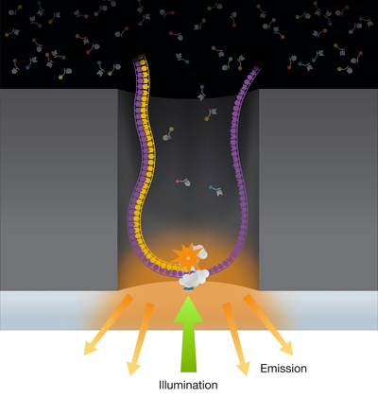
Next next generation sequencing
Pacific Biosystems
Real time DNA synthesis
Up to 12000nt (?)
50 bases/second (?)
Promises delivery of human genome in minutes?
Company on track for 2013
Notes:
Nanopore sequencing
Nucleic acids driven through a nanopore.
Differences in conductance of pore provide readout.
Real-time monitoring of PCR activity
Read-out by fluorescence resonance energy transfer between polymerase and nucleotides or
Waveguides allow direct observation of polymerase and fluorescently labeled nucleotides

Slide 26
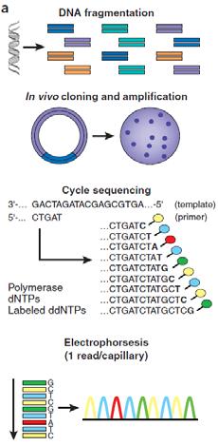


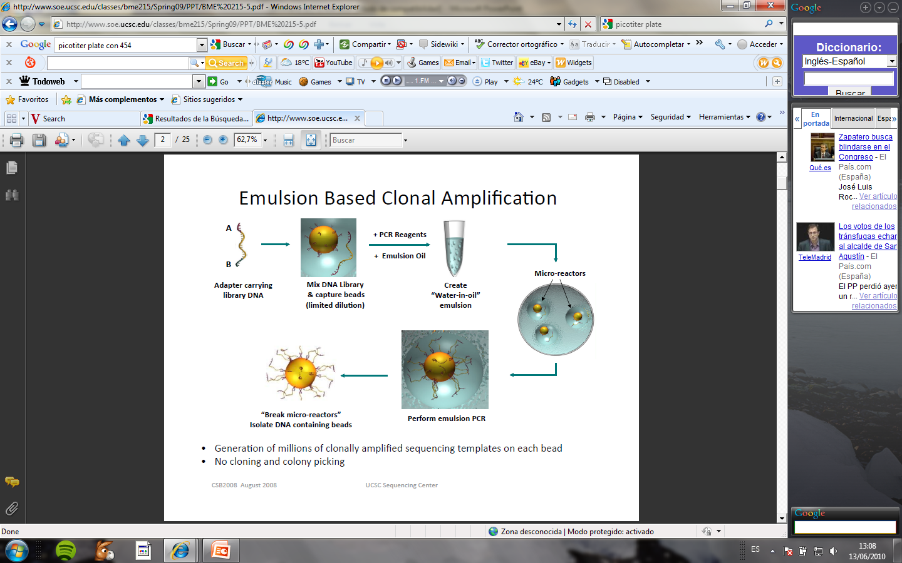

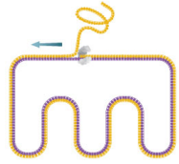

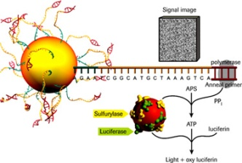
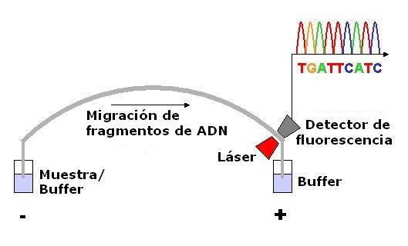
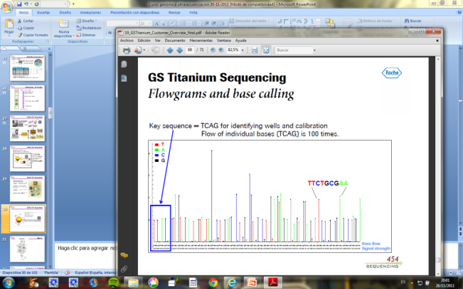
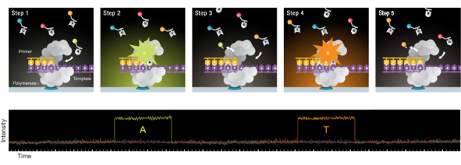
Sanger sequencing vs. NGS (2nd and 3rd generation)
Sanger
2ªNGS
3ªNGS
1. Fragmentación de DNA
1. Fragmentación de DNA
1. Fragmentación de DNA
2.Clonaje en Vectores; Transformación Bacterias; crecimiento y aislamiento vector DNA
2. Ligación de adaptadores in vitro y Amplificación clonal
2. y 3. Ligación de adaptadores in vitro
y Secuenciación masiva
SIN Amplificación
3. Ciclo Secuenciación
3. Secuenciación masiva en paralelo
Secuencia:
Primer:
Polimerasa
dNTPs
ddNTPs marcados
4. Procesamiento imagen
4. Procesamiento imagen y análisis de datos
4. Procesamiento imagen y análisis de datos
Electroforesis
(1 Secuencia/Capilar)
CTATGCTCG

Slide 27
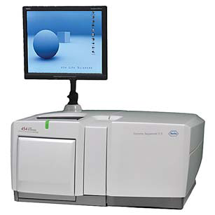
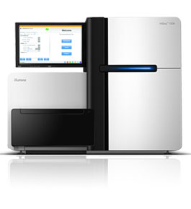
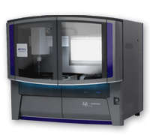
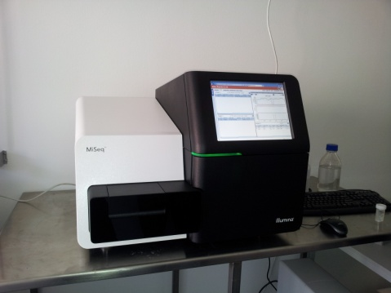
NGS means high sequencing capacity
GS FLX 454
(ROCHE)
HiSeq 2000
(ILLUMINA)
5500xl SOLiD
(ABI)
MiSeq
(ILLUMINA)
Ion TORRENT
GS Junior

Slide 28
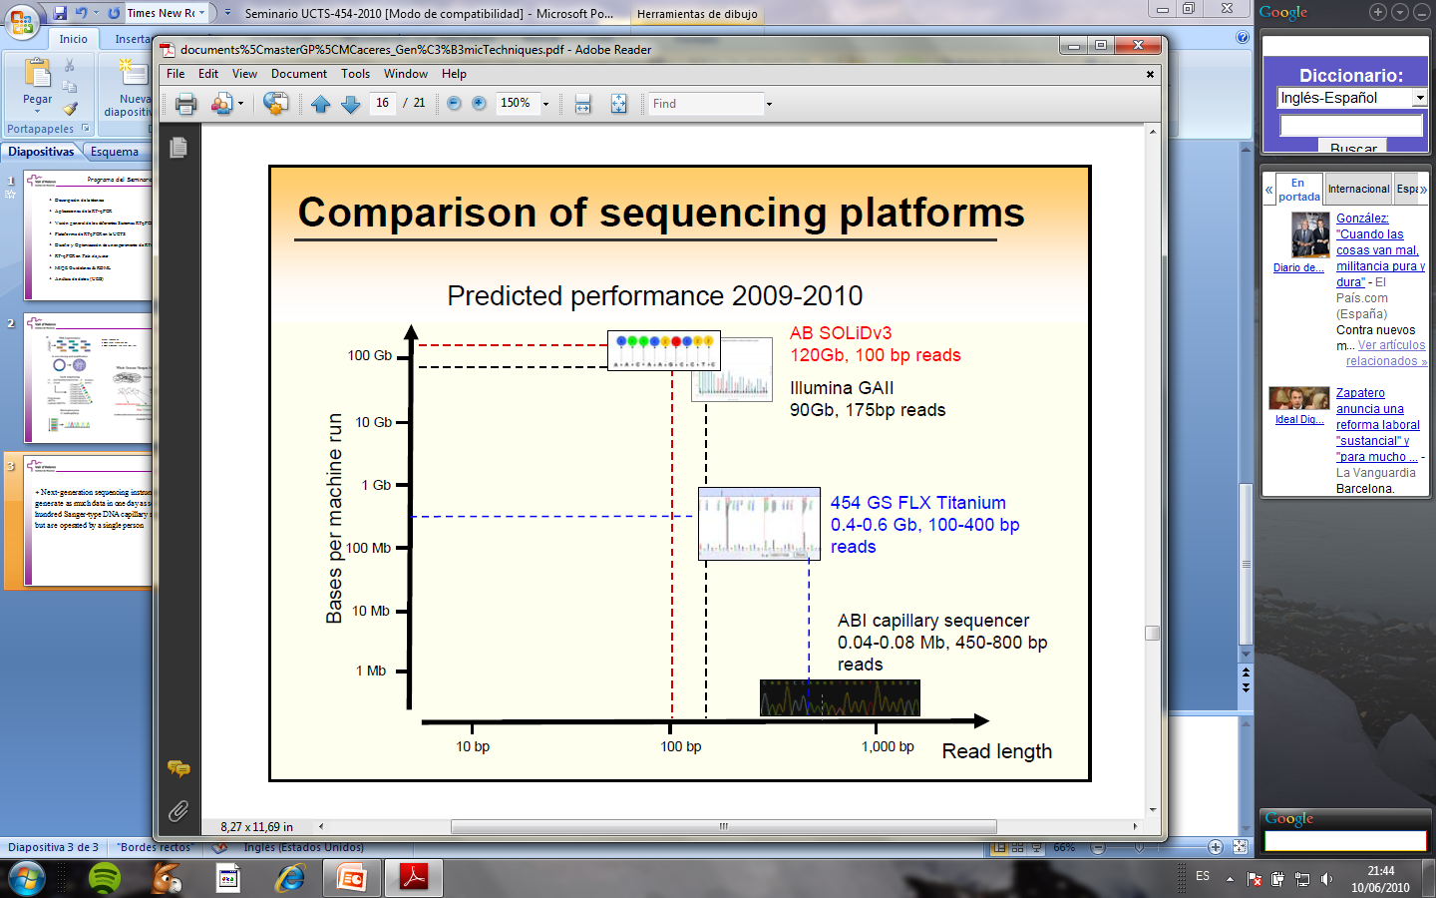
NGS Platforms Performance
454 GS Junior
35MB
Notes:
28
La comparativa incluyendo el método sanger que aunque ofree secs más largas es el que menor rendiiento ofrece.
28

Slide 29
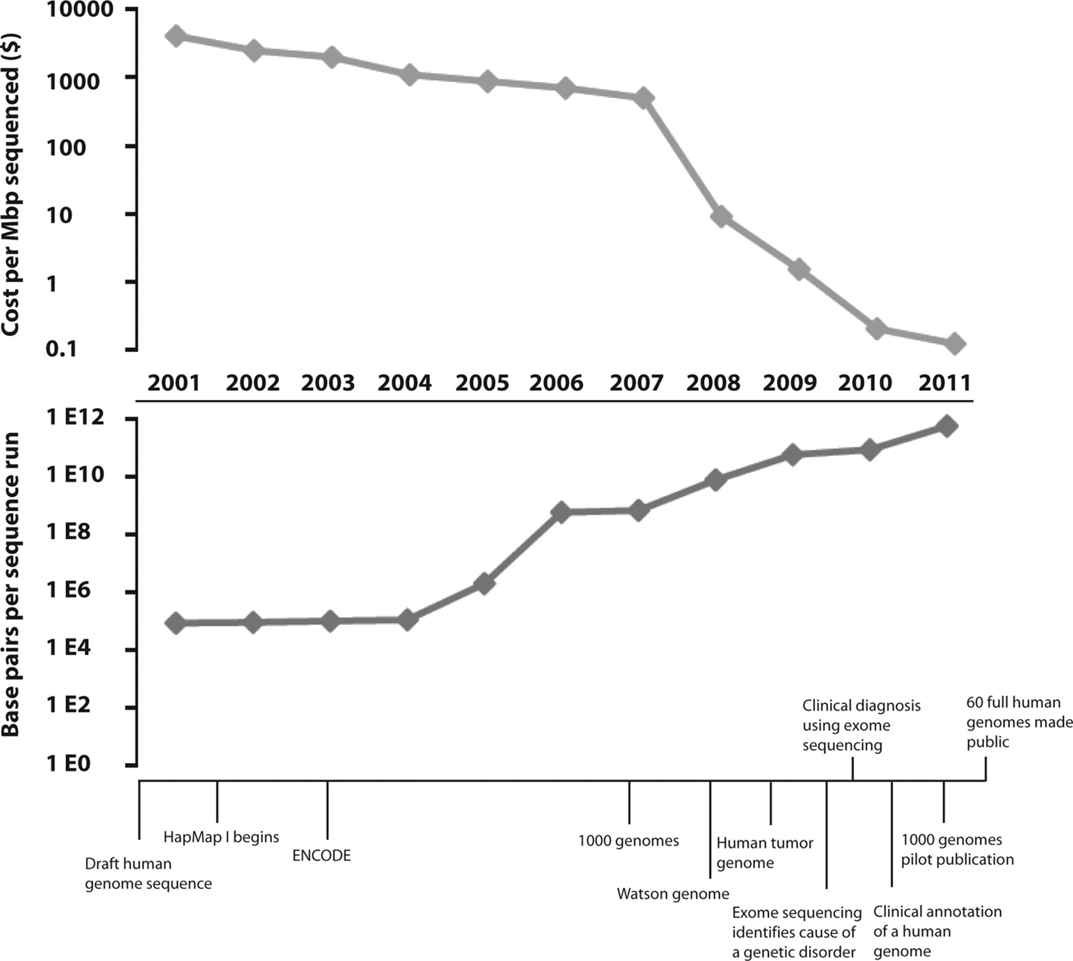
NGS: (much) More per (much) less

Slide 30
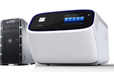
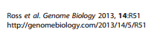
NGS platforms comparison
PLATFORM | ROCHE GS FLX+ 454 | ILLUMINA HISEQ 2500 | ION PROTON
Library preparation | emPCR | Bridge amplification | emPCR
Sequencing chemistry | Pyrosequencing | Reversible dye terminators | pH change
Read length | Up to 1000bp | From 2x125 bp to 2x300 bp | Up to 200 bp
Run time | 22 hrs | 7 hrs-6 days | From 2 to 4 hrs
Throughput/run | Up to 700 Mb | 500-1000Gb | Up to 60 Gb
Equipment Cost | 500.000 $ | 750.000 $ | 250.000 $
Reagents Cost/run | 8.000 $ | 5.500 $ | 1.000 $
GOOD! | Longest read length | High throughput/low cost per base/ease of use | Quick, easy to use and cheap
BAD! | High error rate in homopolymers (>6); very expensive; low throughput; not automatized at all | Short sequences Strand-specific errors, substitutions towards the end of the read, base substitution errors (sistematic error GGT >GGG) | Errors in homopolymers Higher bias than Illumina

Slide 31
Comparison between small sequencers
Next-Gen Sequencer | Machine Cost | Cost per run | Minimum Throughput | Sequencing Run Time | Cost per Mb
Illumina MiSeq | $125,000 | $750 | 1500 Mb (2 x 150 Bases) | 27 Hours | $0.5
454 GS Junior | $108,000 | $1,100 | 35 Mb (400 Bases) | 8 Hours | $31
Ion Torrent PGM- 314 Chip | $80,490 | $225 | 10Mb (100 Bases) | 3 Hours | $22.5
Ion Torrent PGM - 316 Chip | $80,490 | $425 | 100Mb | 3 Hours | $4.25
Ion Torrent PGM - 318 Chip | $80,490 | $625 | 1000Mb | 3 Hours | $0.63

Slide 32
Bioinformatics challenges of NGS

Slide 33
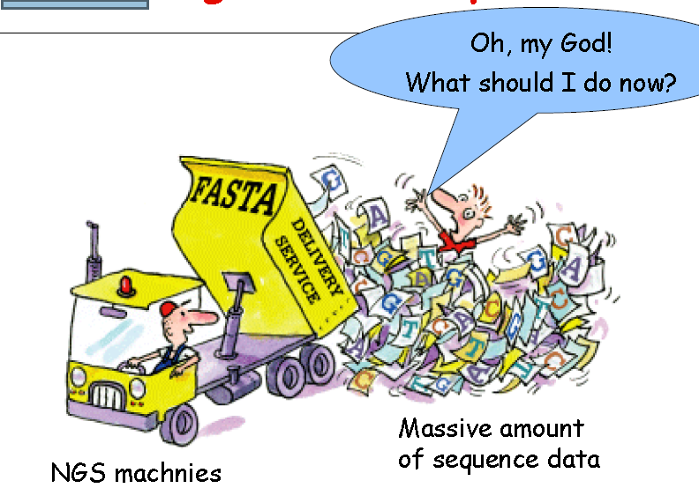
I have my sequences/images. Now what?

Slide 34
NGS pushes (bio)informatics needs up
Need for large amount of CPU power
Informatics groups must manage computer clusters
Challenges in parallelizing existing software or redesign of algorithms to work in a parallel environment
Another level of software complexity and challenges to interoperability
VERY large text files (~10 million lines long)
Can’t do ‘business as usual’ with familiar tools such as Perl/Python.
Impossible memory usage and execution time
Impossible to browse for problems
Need sequence Quality filtering

Slide 35
Data management issues
Raw data are large. How long should be kept?
Processed data are manageable for most people
20 million reads (50bp) ~1Gb
More of an issue for a facility: HiSeq recommends 32 CPU cores, each with 4GB RAM
Certain studies much more data intensive than other
Whole genome sequencing
A 30X coverage genome pair (tumor/normal) ~500 GB
50 genome pairs ~ 25 TB

Slide 36
So what?
In NGS we have to process really big amounts of data, which is not trivial in computing terms.
Big NGS projects require supercomputing infrastructures.
Or put another way: it's not the case that anyone can do everything.
Small facilities must carefully choose their projects to be scaled with their computing capabilities.

Slide 37
Computational infrastructure for NGS
Infrastructures of different size
Small,
Medium,
Big
provide diverse capabilities
for a wide range of project types.

Slide 38
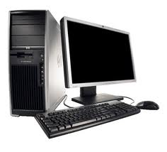
Small infrastructure
Recommended at least 2 machines
8 or 12 cores each machine.
48Gb ram minimum each machine.
BIG local disk. At least 4TB each machine
As much local disks as we can afford
Price range: starting at 8.000€ - 10.000€ (2 machines)
Can do
RNA-seq analysis
Small metagenomic projects
A few exomes

Slide 39
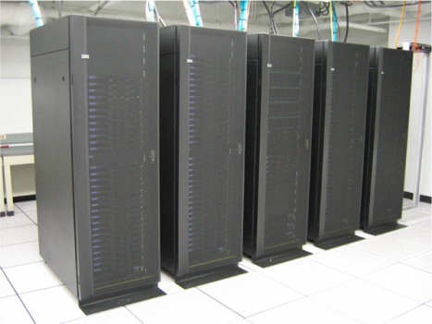
Middle size infrastructure
"Small” distributed filesystem ( around 50TB).
"Small” cluster (10 nodes, 80 to 120 cores).
Gigabit ethernet network.
Price : 50.000 – 100.000 € (just hardware) plus data center and informaticians salary
Can do
Genome assembly
More than-a-few exomes
Middle-sized metagenomics.

Slide 40
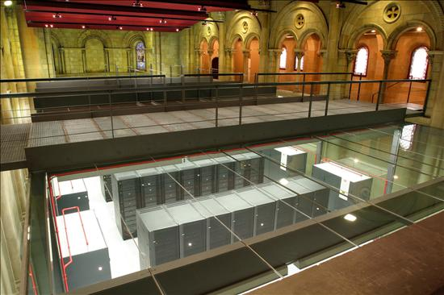
Big computing infrastructure
Distributed memory cluster
Starting at 20 computing nodes
160 to 240 cores
At least 48GB ram per node
Fast networks (10Gbit or Infiniband
Batch queue system (sge, condor, pbs, slurm)
Optional MPI and GPUs environment
Good for large-scale projects (big data at last)
Quick assembly of human genomes
Hundreds/Thousands of exomes
Large metagenomic projects
Very expensive to acquire and maintain
Notes:
InfiniBand (http://en.wikipedia.org/wiki/InfiniBand ) is a switched fabric communications link used in high-performance computing and enterprise data centers.
Its features include high throughput, low latency, quality of service and failover, and it is designed to bescalable.
The InfiniBand architecture specification defines a connection between processor nodes and high performance I/O nodes such as storage devices.
InfiniBand forms a superset of the Virtual Interface Architecture.

Slide 41
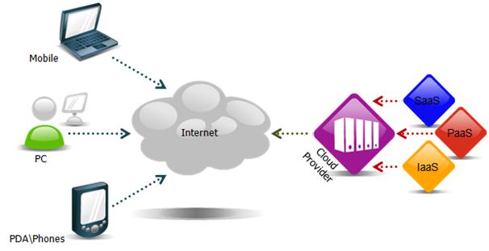
Alternatives (1): Cloud Computing
Pros
Flexibility.
You pay what you use.
Don´t need to maintain a data center.
Cons
Transfer big datasets over internet is slow.
You pay for consumed bandwidth. That is a problem with big datasets.
Lower performance, specially in disk read/write.
Privacy/security concerns.
More expensive for big and long term projects.

Slide 42
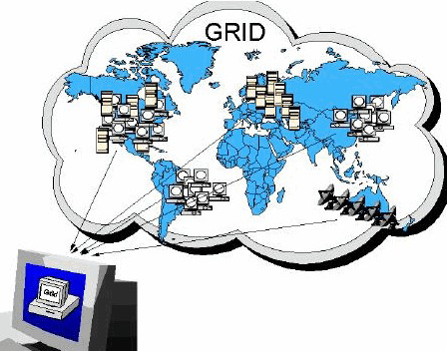
Alternatives (2): Grid Computing
Pros
Cheaper.
More resources available.
Cons
Heterogeneous environment.
Slow connectivity (specially in Spain).
Much time required to find good resources in the grid.

Slide 43

So what?
Think before you NGS
Decide what you …
want to do,
can afford
know how to do
Consider all alternatives
Look for expert advice …

Slide 44
Software for NGS data analysis

Slide 45
Which software for NGS (data) analysis?
Answer is not straightforward.
Many possible classifications
Biological domains
SNP discovery, Genomics, ChIP-Seq, De-novo assembly, …
Bioinformatics methods
Mapping, Assembly, Alignment, Seq-QC,…
Technology
Illumina, 454, ABI SOLID, Helicos, …
Operating system
Linux, Mac OS X, Windows, …
License type
GPLv3, GPL, Commercial, Free for academic use,…
Language
C++, Perl, Java, C, Phyton
Interface
Web Based, Integrated solutions, command line tools, pipelines,…
http://seqanswers.com/wiki/Software/list

Slide 46
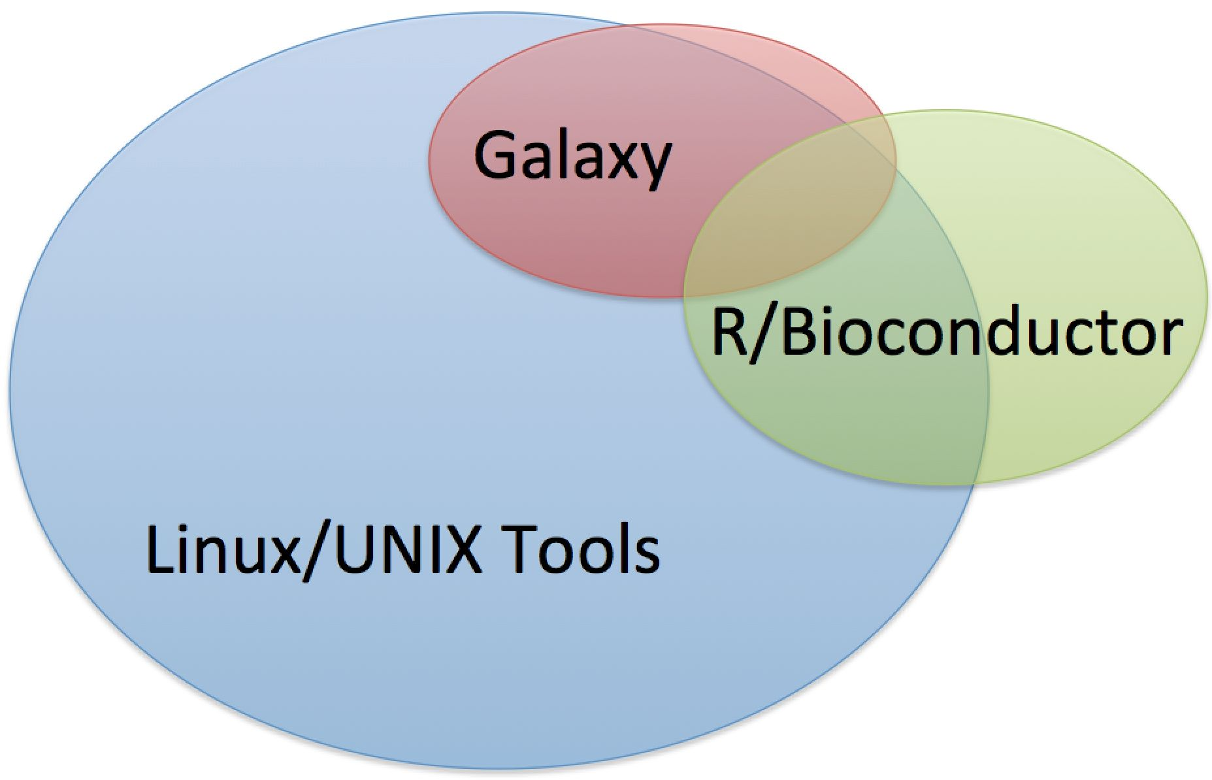


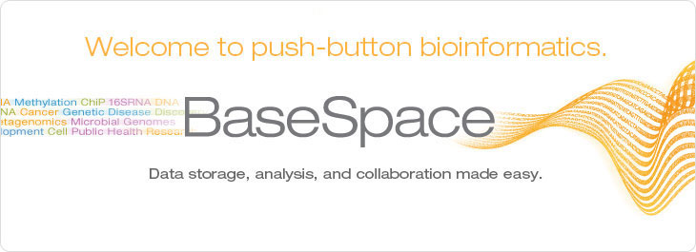

Slide 47
NGS data analysis

Slide 48
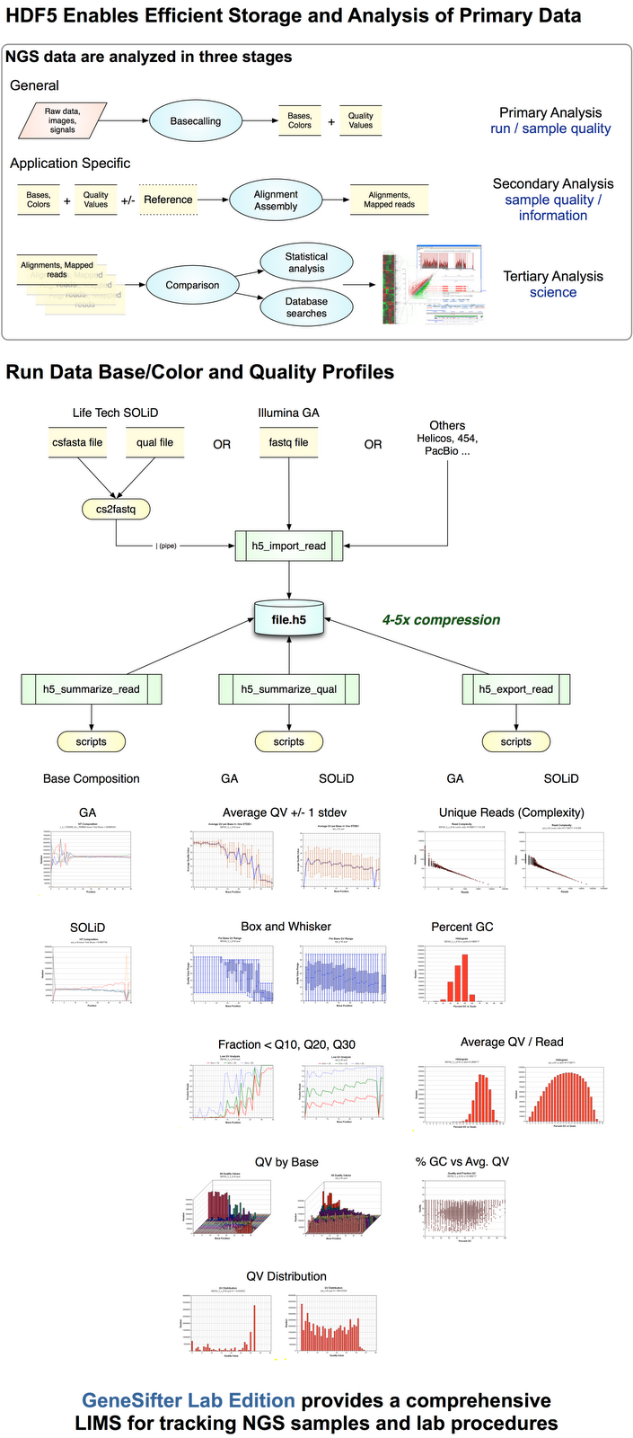
NGS data analysis stages

Slide 49
NGS applications

Slide 50
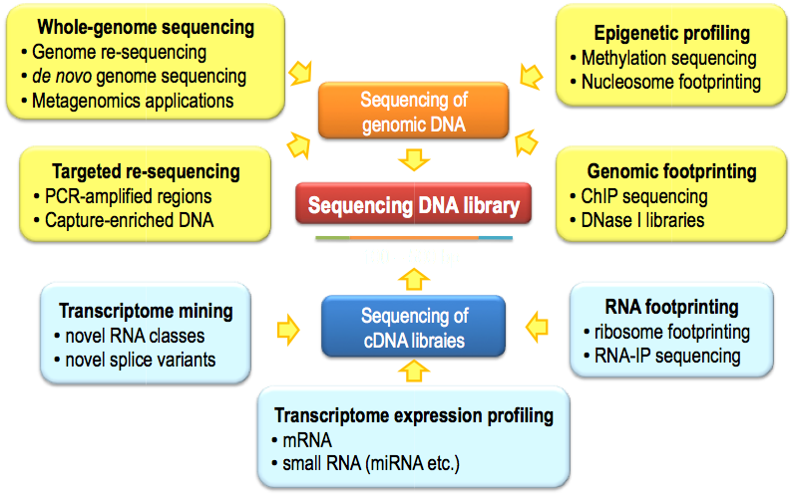
Applications of Next-Generation Sequencing

Slide 51
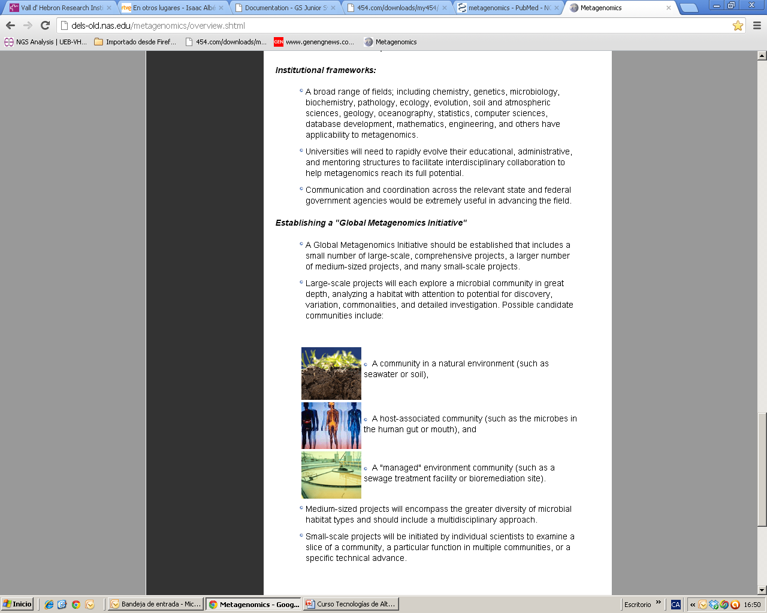
Metagenomics
Metagenomics is the study of a collection of genetic material (genomes) from a mixed community of organisms. Metagenomics usually refers to the study of microbial communities.
The biosphere contains between 10³⁰ and 10³¹ microbial genomes, at least 2–3 orders of magnitude more than the number of plant and animal cells combined.
Microbes associated with the human body outnumber human cells by at least a factor of ten.
The vast majority cannot be cultured.
What can we study?

Slide 52
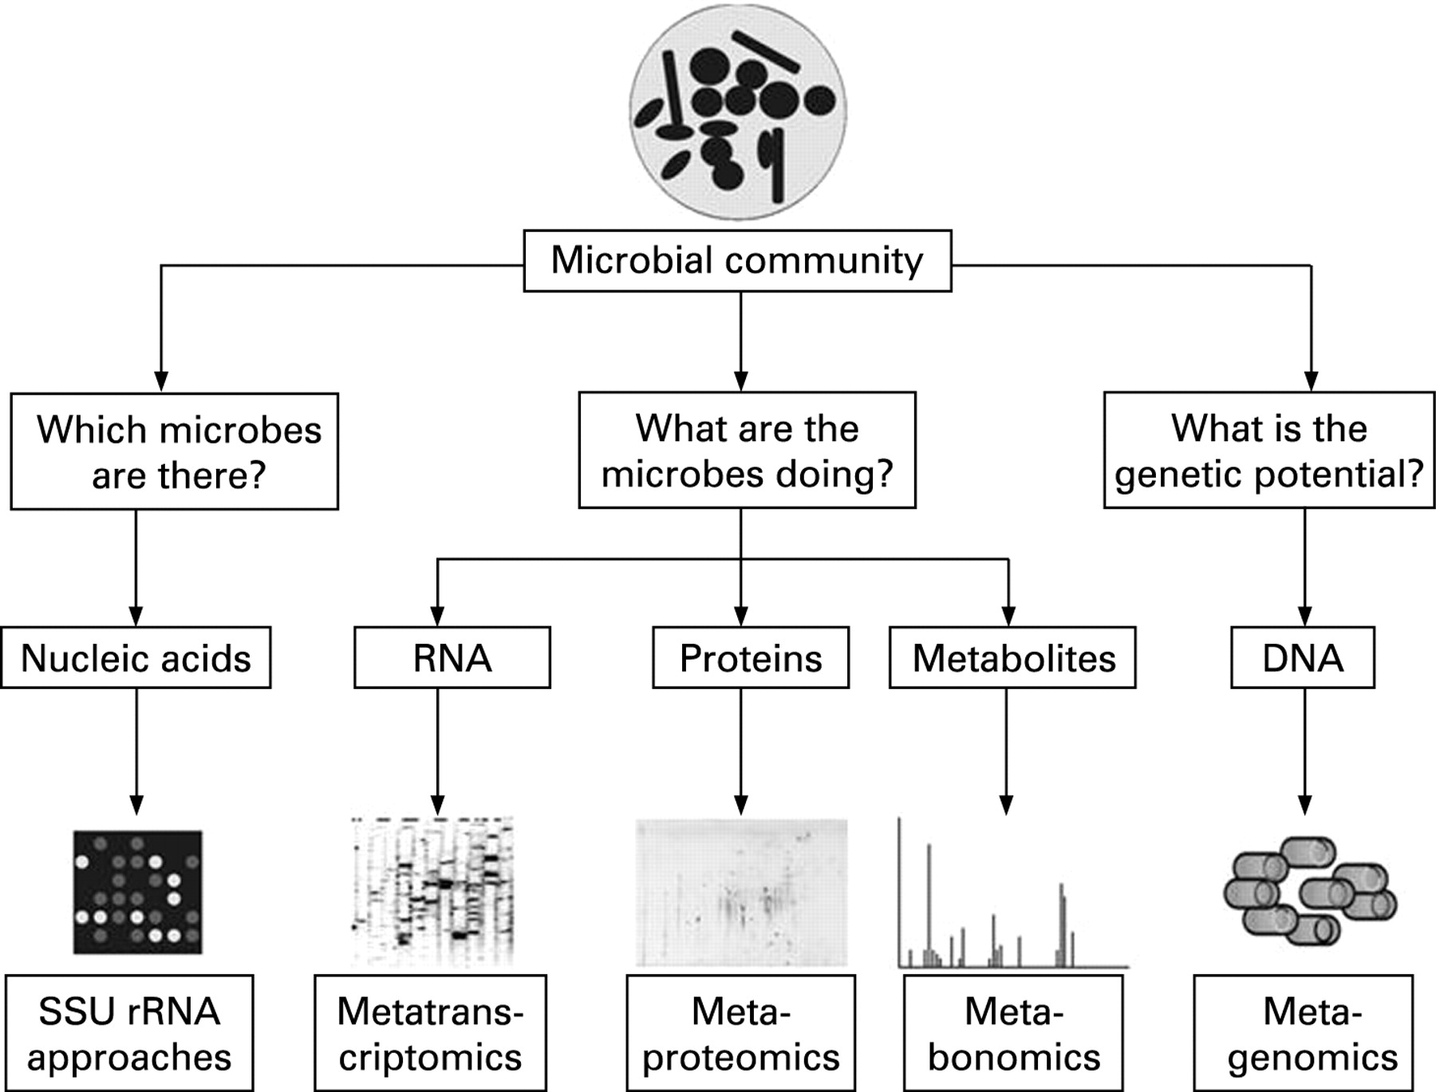
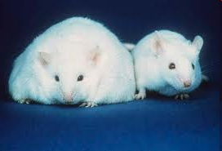

Metagenomics and other community-based “omics”
Zoetendal E G et al.
Gut 2008;57:1605-1615
Notes:
Schematic representation of the metagenomics and other community-based “omics” approaches. SSU rRNA, small subunit ribosomal RNA.

Slide 53
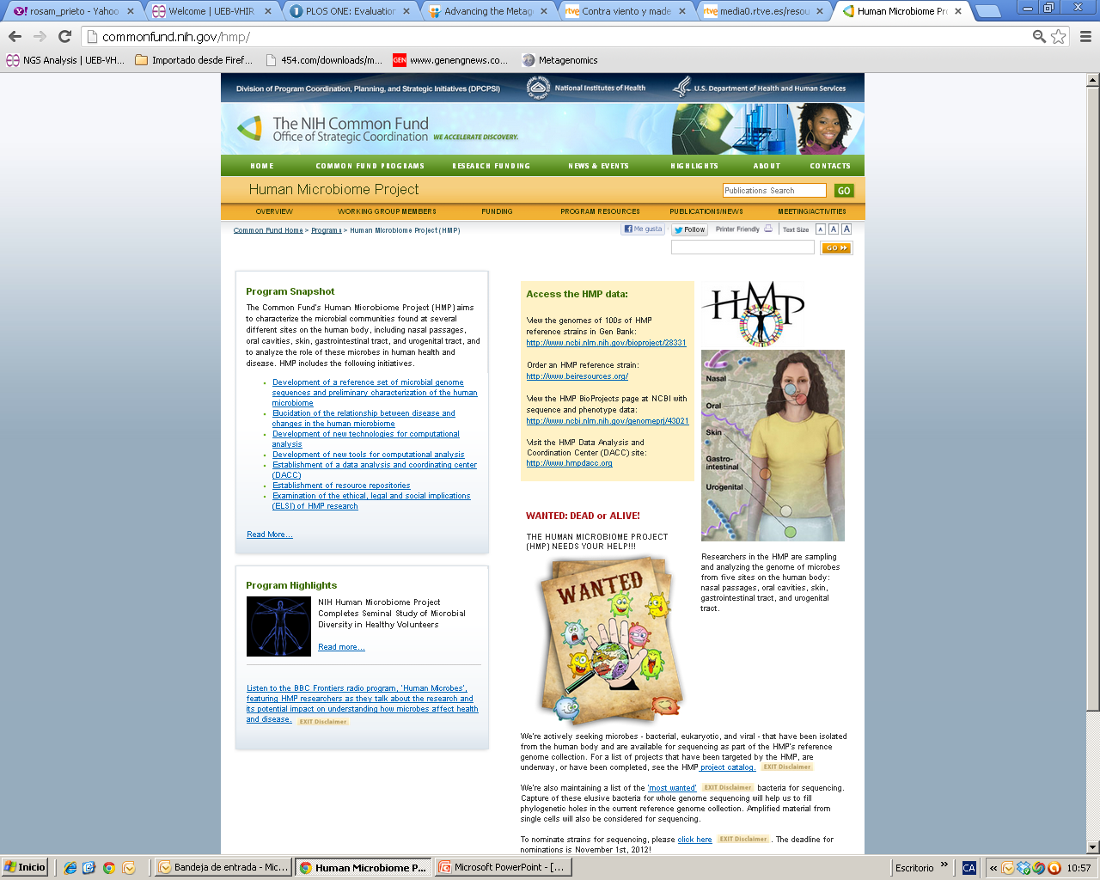
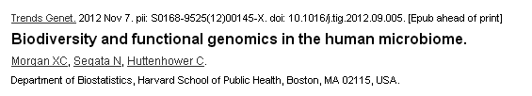
Metagenomic Studies
2
NIH Human Microbiome Project

Slide 54
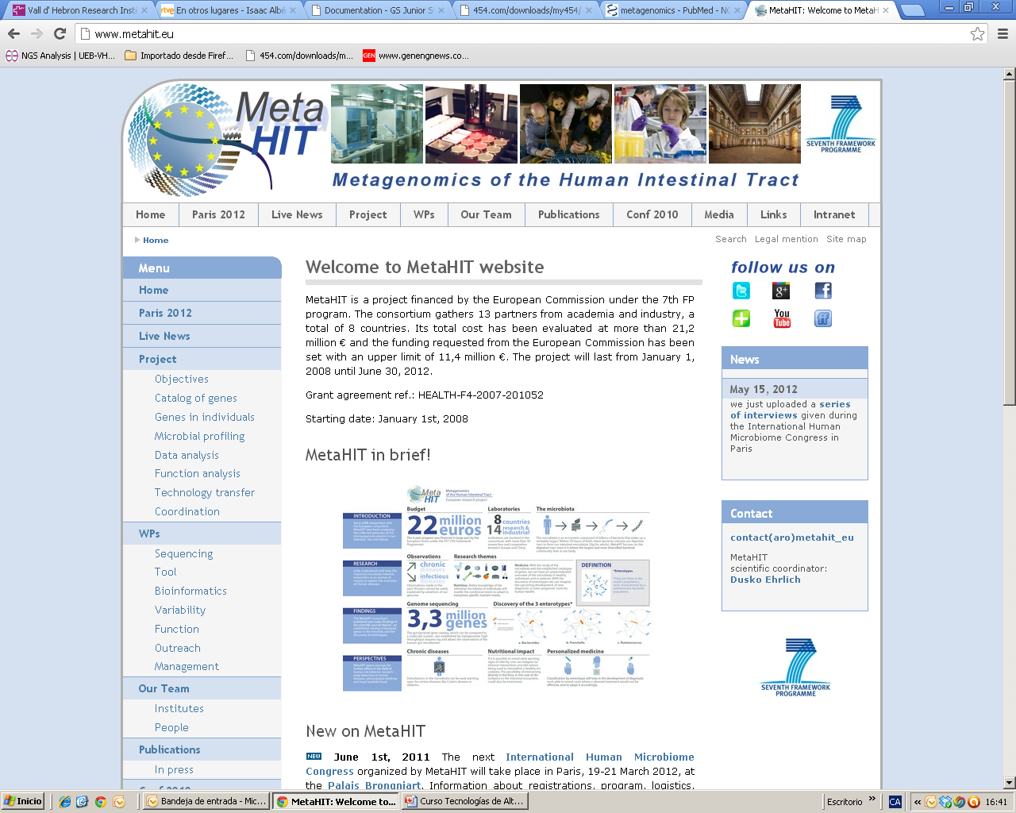
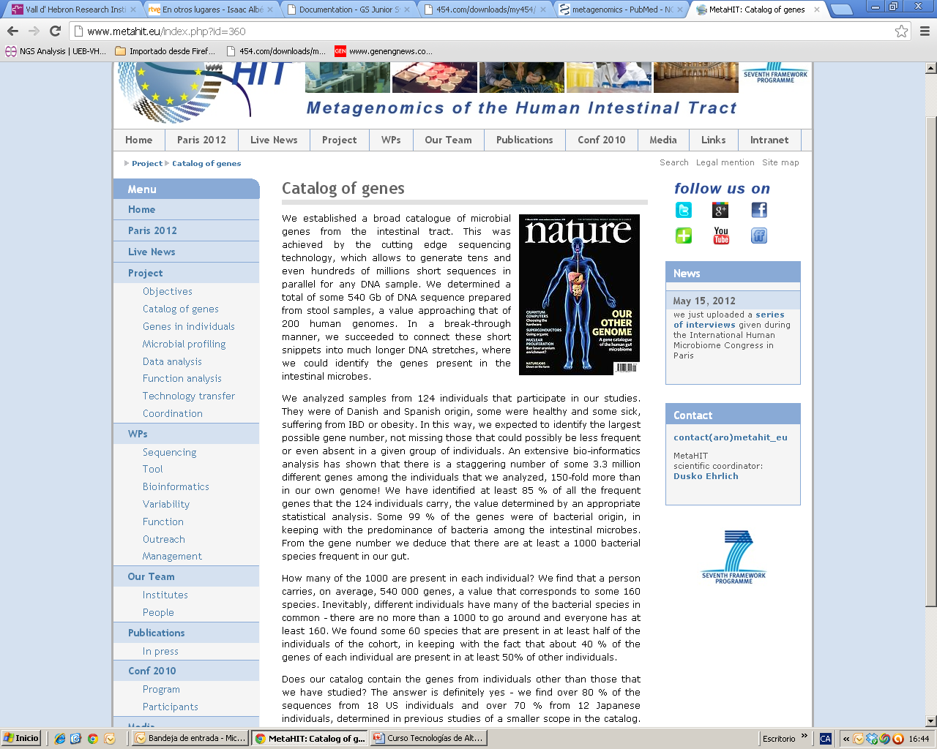
Metagenomic Studies
2
To establish associations between the genes of the human intestinal microbiota and our health and disease.
Focused on two disorders of increasing importance in Europe, Inflammatory Bowel Disease (IBD) and obesity.

Slide 55
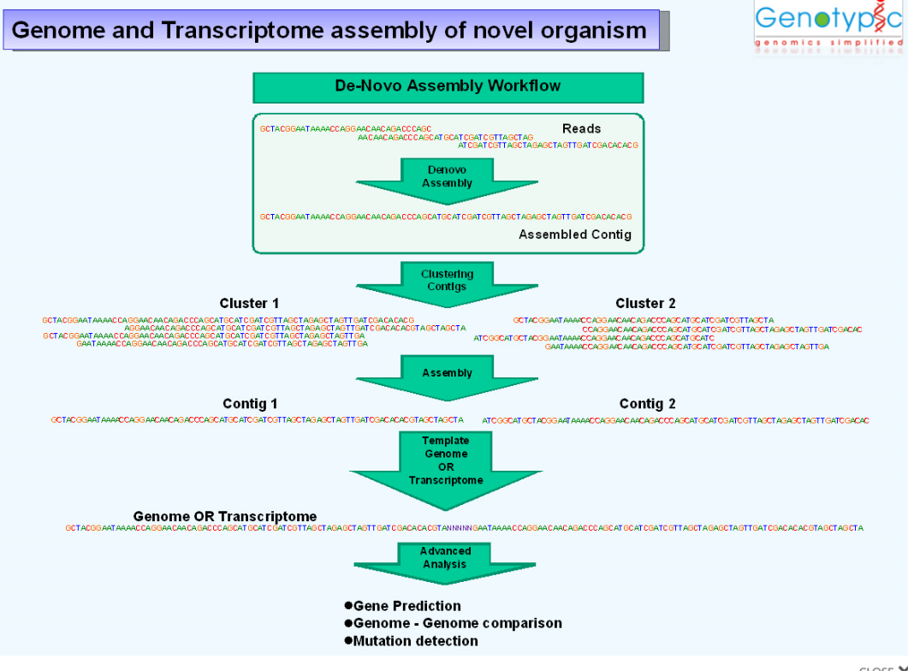
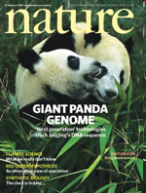
De novo sequencing

Slide 56




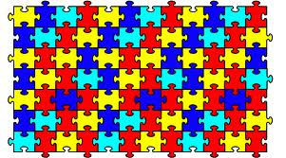



Sequencing vs re-sequencing
Case A: There is no reference geneome available ( “de novo” sequencing)
Case B: There exists a reference genome available (resequencing)

Slide 57
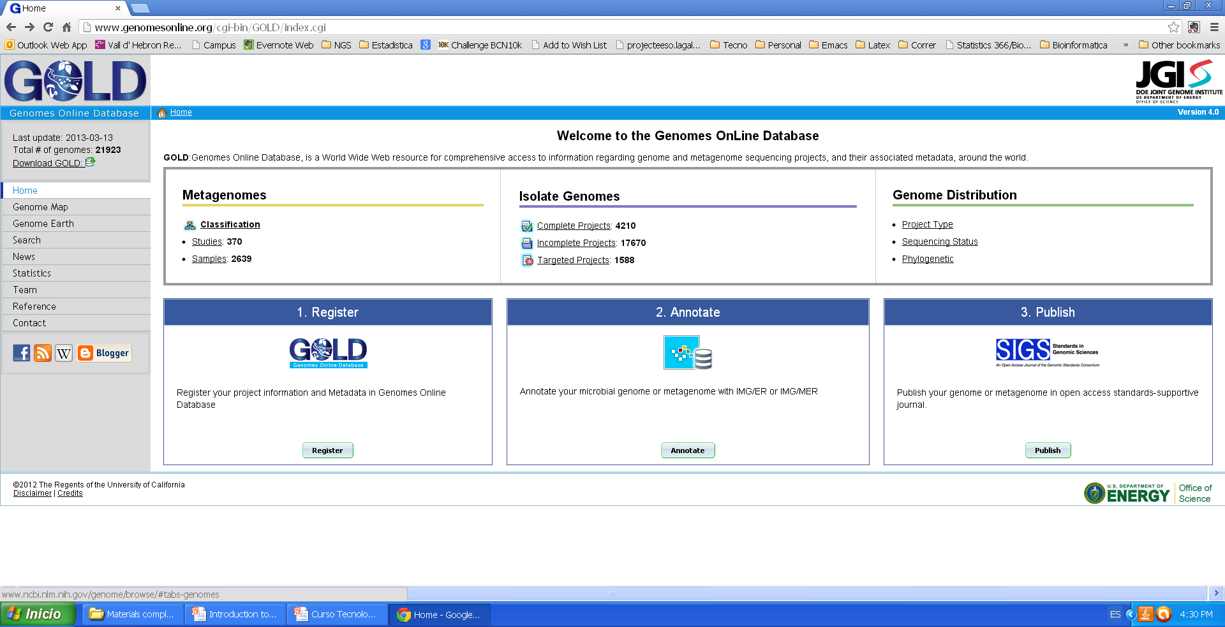
Which genomes have been sequenced

Slide 58
Exome Sequencing
Capturing protein coding portion of the genome
~85% of the disease-causing mutations occur in protein coding regions (exome)
Exome constitutes 1% of the genome
About 160,000-180,000 exons
Time-saving and cost-effective

Slide 59
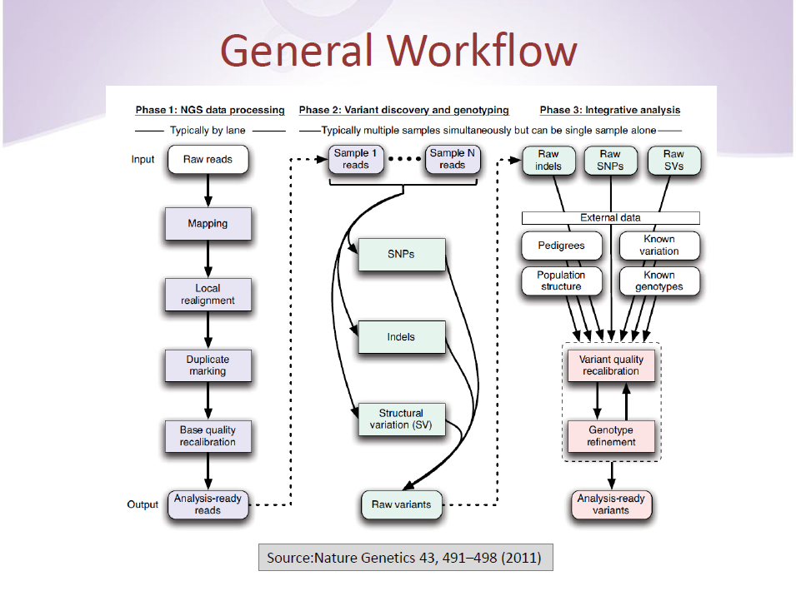

Slide 60
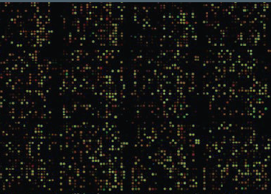

Transcriptomics by NGS: RNASeq
Analog Signal
Easy to convey the signal’s information
Continuous strength
Signal loss and distortion
Digital Signal
Harder to achieve & interpret
Reads counts: discrete values
Weak background or no noise

Slide 61
Applications → Whole transcriptome analysis
mRNA
AAAA
Fragmentation
Detects (differential) expression of known and novel mRNAs
RT
Identification of alternative splicing events
cDNA library
Detects expressed SNPs or mutations
sequencing
Identifies allele specific expression patterns
Reads cover the full length of a transcript

Slide 62

Microarray vs RNA seq data analysis

